Slide 1
STA326: Data Science Practice
Wei Hongxin
2026 Spring

Slide 2
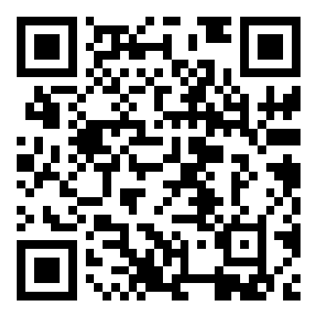
Who are we?
https://hongxin001.github.io/
魏鸿鑫
Assistant Professor at Stat-DS
Research interests: reliable machine learning, and its applications in data optimization and privacy
Ph.D., Nanyang Technological University, 2020 – 2023
Visiting Scholar, University of Wisconsin Madison, 2022
Research Assistant, The IIIS at Tsinghua University, 2017-2018
Bachelor, Huazhong University of Science and Technology, 2012-2016
Teaching Assistant
Wang Shuoyuan (王朔远)
Yang Hanjie (杨汉杰)
Wang Boyuan (王伯元)
Lab Instructor
Song Anqi (宋安琪)

Slide 3
Outlines
Course Objective
Timelines of STA326
Overview of STA326 assignments
Final Project

Slide 4


Data Science Practice?
Deep Learning Practice!

Slide 5
Course Objective
Apply machine learning algorithms to real-world tasks
Train a strong model for a given dataset.
How to choose loss/optimizer/neural network/regularization?
How to augment/generate data for training a stronger model?
We focus on Image data and mostly classification.

Slide 6
In this class, you will
Learn how to train deep neural networks
Chance to apply for research internship in various groups.
Know some applications of cutting-edge technologies (like RAG)

Slide 7
Course Syllabus
Part 1: Deep Learning Basics (Week 1-5)
Part 2: Predictive models (Week 6, 7, 9)
(Week 8: Mid-term exam)
Part 3: Generative models (Week 10-12)
Part 4: Advance Topics (Week 13-14)
Transformer, RAG…
(Week 15: Project presentation)

Slide 8

Book
Part 1: Deep Learning Basics (Week 1-5)
Chapters 1, 3, 4, 5, 12
Part 2: Predictive models (Week 6, 7, 9)
Chapters 7, 8, 14
Part 3: Generative models (Week 10-12)
Chapter 20
Part 4: Advance Topics (Week 13-14)

Slide 9
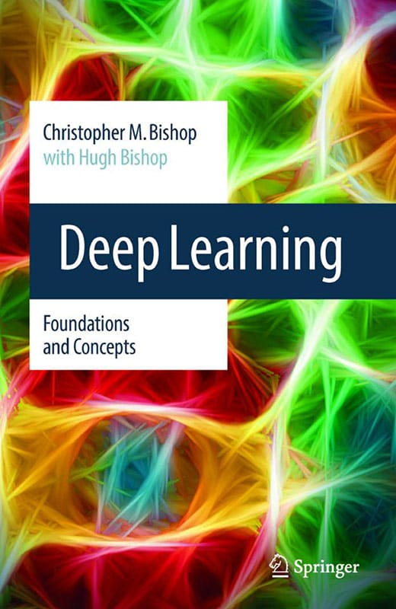
Book
Part 1: Deep Learning Basics (Week 1-5)
Chapter 1, 4, 5, 6, 7, 8, 9
Part 2: Predictive models (Week 6, 7, 9)
Chapter 10
Part 3: Generative models (Week 10-12)
Chapter 17, 20
Part 4: Advance Topics (Week 13-14)

Slide 10
Grading Formula
Grade(100) = Ca (10) + FP (30) + A (30) + M(30)
Ca – Course attendance
FP – Final Project
A - Assignment
M - Midterm
Active Participation = +1 bonus when you need it

Slide 11
Assignments
1st assignment: Week 5 (Training a model on a standard dataset)
2nd assignment: Week 10 (Project midterm report)
3rd assignment: Week 13 (Generate some image data)
Submit on time with at most 1 late days.

Slide 12
Prerequisites
Basic programming skills (especially Python)
Familiar with the probability theory
Familiar with linear algebra

Slide 13
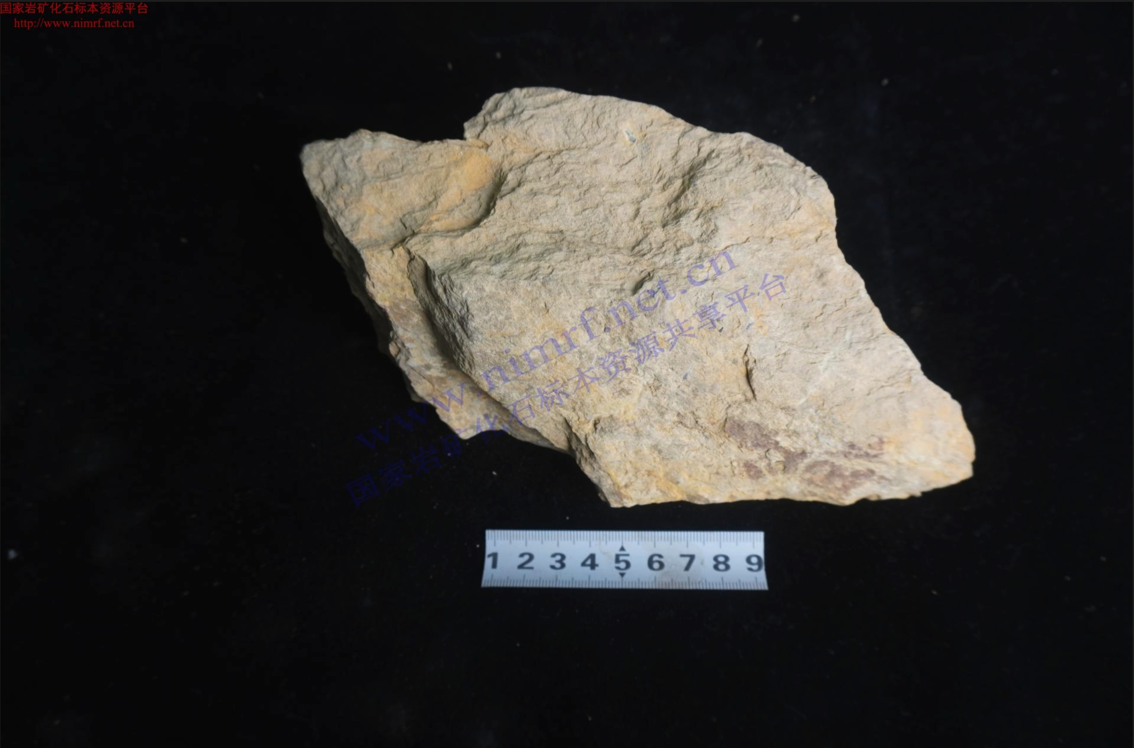
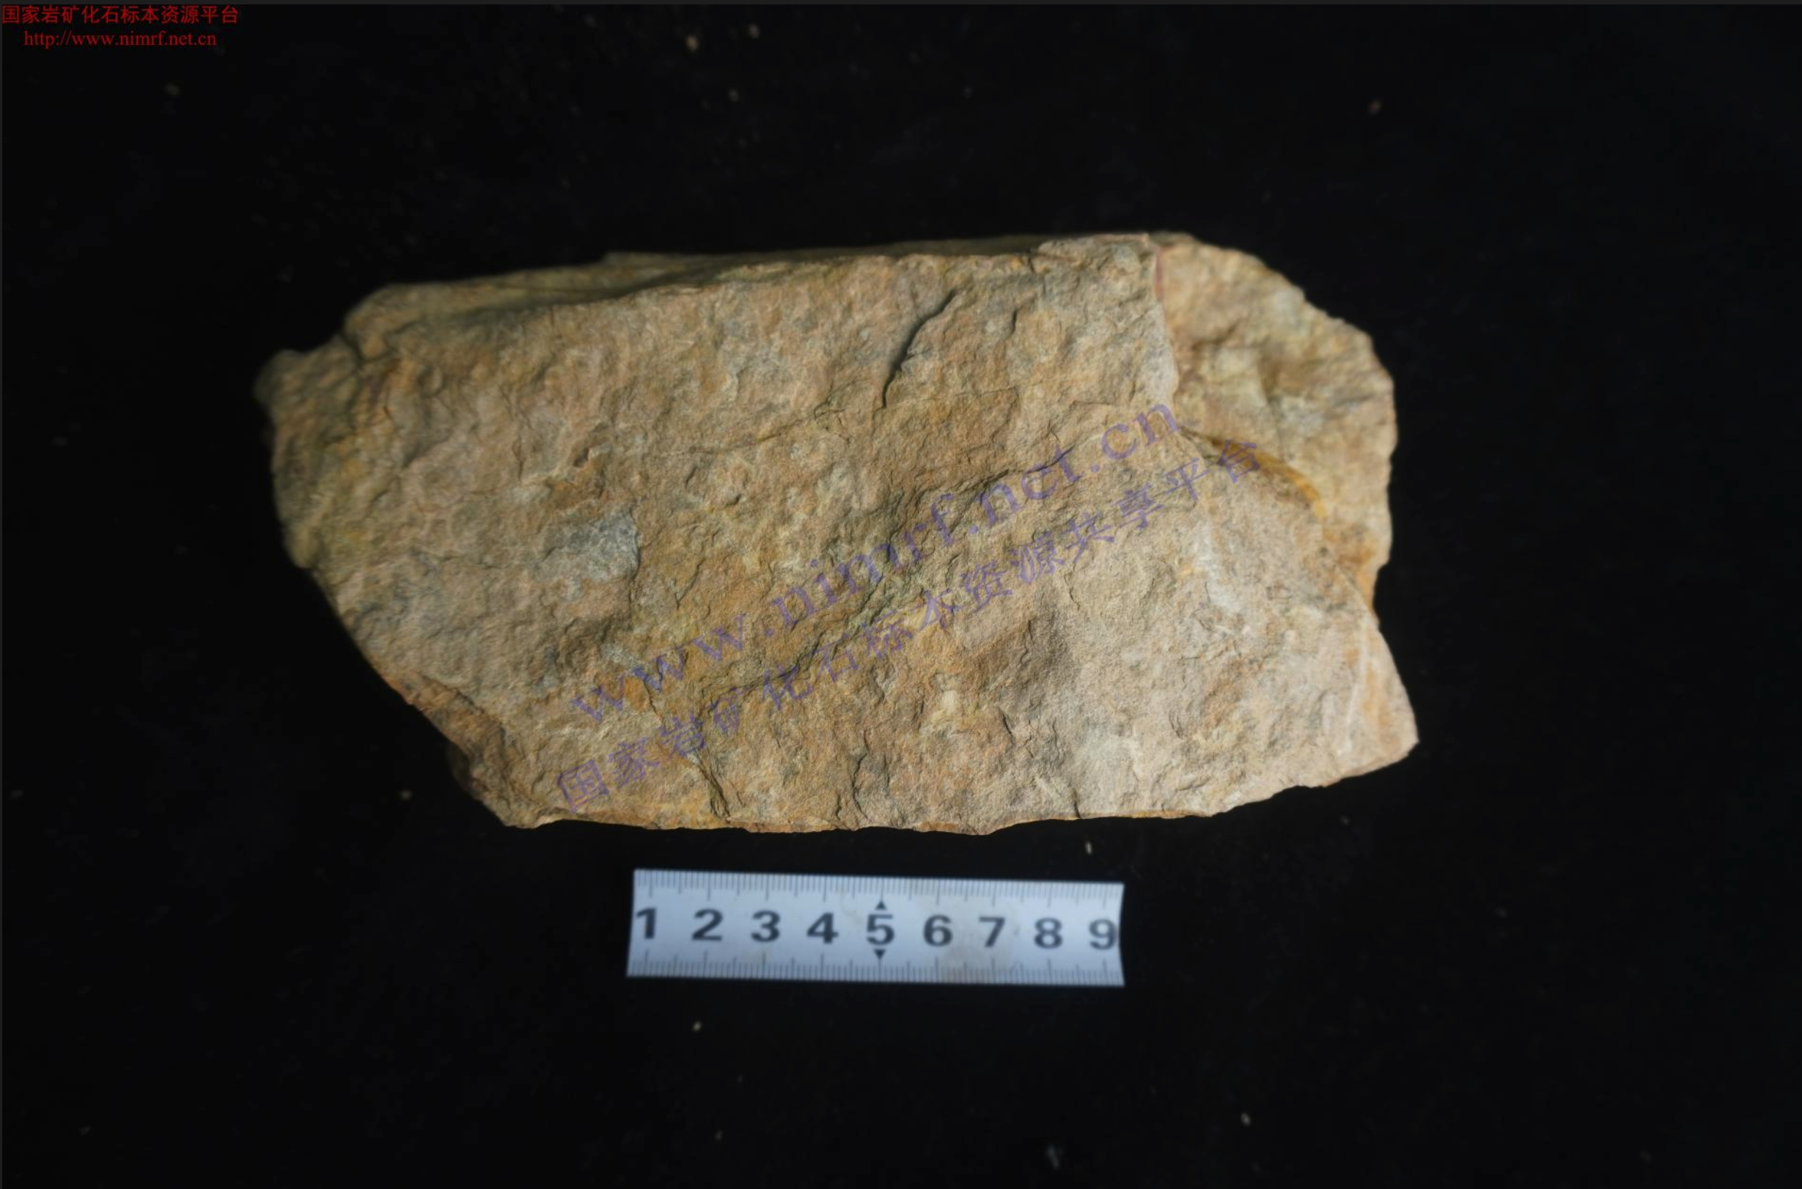
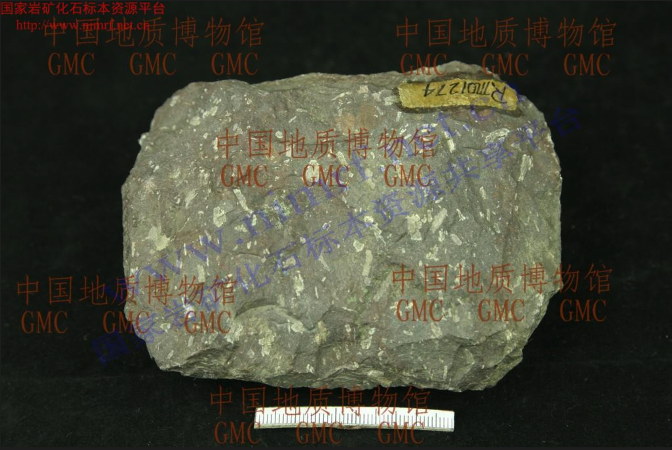
Final project (2025 Spring)
Rock Classification （The project will be released in week 2-3）
Now you are a research scientist, and the rock museum hope you to train a deep model that can classify rock images into different classes. With the classification model, they can automatically collect rocks for various classes.
变质岩
沉积岩
火成岩

Slide 14
Final project
We support self-customized projects
Suggestions for high rating:
Train a model that can be directly applied in daily life.
Construct the dataset by yourself, instead of using standard datasets.
Adopt some cutting-edge technologies to improve the performance.
We show some great student projects from CS-230 Stanford

Slide 15
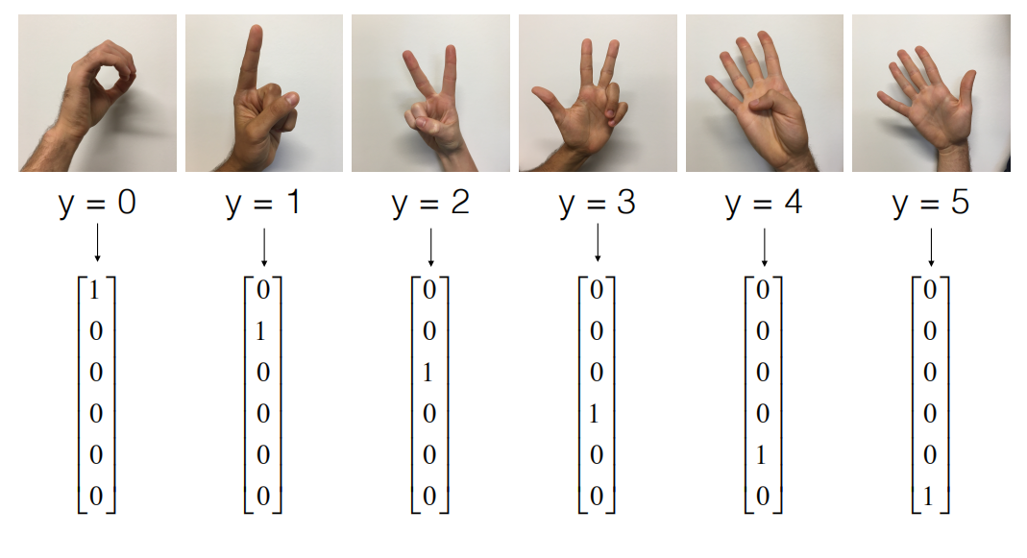
Examples: Sign Language image classification

Slide 16
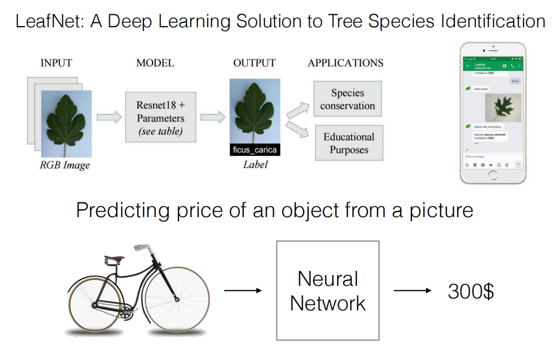
Examples: LeafNet

Slide 17
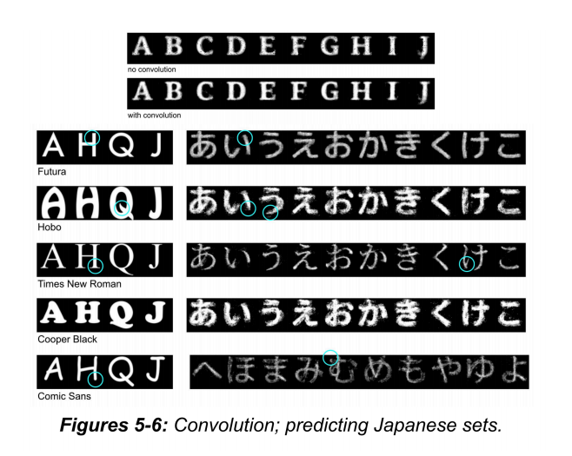
Examples: Inferring Alternate Language Sets from Fonts

Slide 18
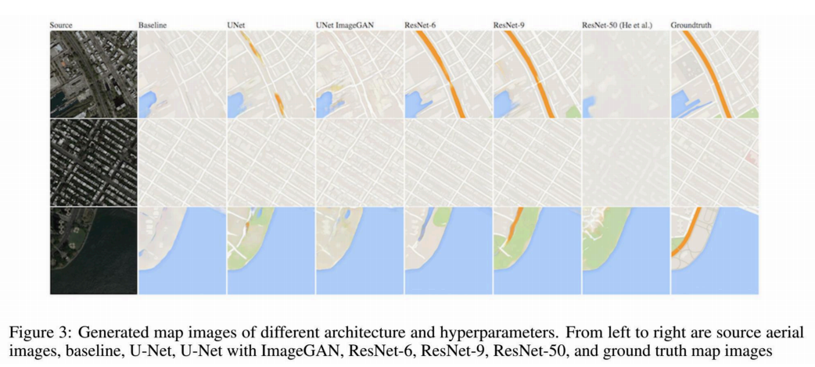
Examples: Image-to-Image translation with Conditional-GAN

Slide 19
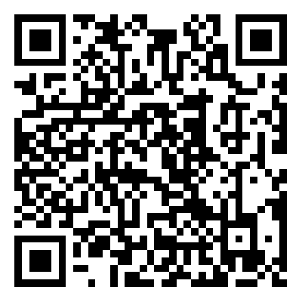
Check more projects…
https://cs230.stanford.edu/past-projects/

Slide 20
Any question?

